Slide 1
REGIONAL ANESTHESIA
Femoral Nerve Block and Adductor Canal Block
Intraoperative teaching · CA-1
Same-day build — drafted on https://ollama.com (glm-5.2:cloud)
Peripheral Nerve Blocks: Indications, Contraindications, Techniques and Comparisons of Techniques, Complications · Extremities Including Brachial Ple…
DRAFT — NOT APPROVED, NOT FOR TEACHING. Preview for review only; no attending has approved this deck.
Notes:
Assertion-per-slide deck. Each teaching point is one slide, and each carries the paper it came from in the footnote — open it if a claim matters to your case.

Slide 2
HOW TO USE THIS
Read the assertions, argue with the questions
5 evidence-linked points, then 4 questions you will actually be asked.
Every point cites a paper
Your attending reviewed this
It is not a protocol
The footnote on each slide is the source it was drawn from. If a point matters to your case, open it.
Points that could not be traced to a resolvable source were removed before you saw it.
Institutional policy and the attending in the room both override anything here.
Every point on the following slides resolved to a source that exists. Open any of them.
DRAFT — NOT APPROVED, NOT FOR TEACHING. Preview for review only; no attending has approved this deck.
Notes:
Pitched at CA-1.

Slide 3
THE QUESTION
Where the evidence disagrees
This topic was selected because an evidence synthesis beats a textbook on it: the trials disagree, or the guidance has moved recently.
DRAFT — NOT APPROVED, NOT FOR TEACHING. Preview for review only; no attending has approved this deck.

Slide 4
THE EVIDENCE
What each source contributes, and how strong it is
Study design first — a cohort and a randomised trial do not carry the same weight.
Design | Year | Journal | What it found
Meta-analysis | 2025 | Journal of pediatric orthopedics | This systematic review found that adding a sciatic nerve block to a femoral nerve
Randomised trial | 2024 | The journal of knee surgery | This randomized trial found that for knee arthroscopy, intra-articular local
Meta-analysis | 2024 | The Clinical journal of pain | This network meta-analysis of adults undergoing primary total knee arthroplasty
Randomised trial | 2021 | Archives of orthopaedic and trauma | This randomised controlled trial found that femoral nerve block and adductor canal
Meta-analysis | 2024 | PloS one | This meta-analysis of knee arthroplasty patients found that continuous adductor
5 resolved citations behind this deck; every point above traces to one of them.
DRAFT — NOT APPROVED, NOT FOR TEACHING. Preview for review only; no attending has approved this deck.

Slide 5
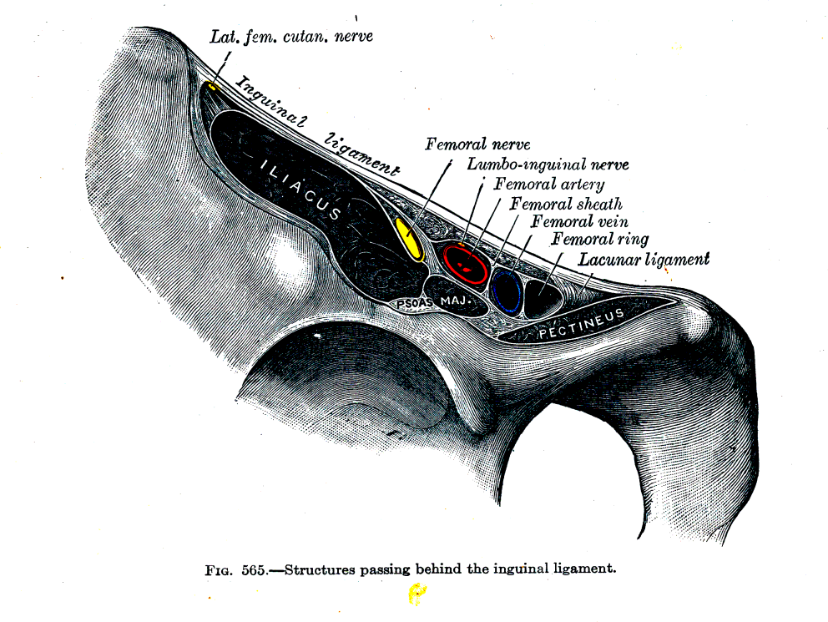
THE ANATOMY
The femoral nerve is outside the sheath, so the block is placed lateral to the artery
The vessels are wrapped in the femoral sheath and the nerve is not, which is why local anaesthetic has to go lateral to the artery rather than around it.
SOURCE
[1] Henry Gray — Medical illustration of the inguinal ligament and associated nerves and arteries. Anterolateral view of the right side of the pelvis. Figure 565 from Gray's Anatomy, 21st edition (1924) · https://commons.wikimedia.org/wiki/File:Structures_passing_behind_the_inguinal_ligament.png
Henry Gray · public-domain · https://commons.wikimedia.org/wiki/File:Structures_passing_behind_the_inguinal_ligament.png
DRAFT — NOT APPROVED, NOT FOR TEACHING. Preview for review only; no attending has approved this deck.

Slide 6
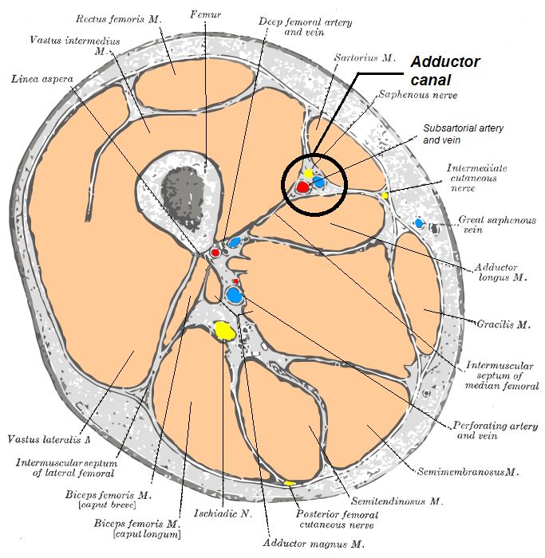
THE ANATOMY
By the adductor canal the nerve is sensory, and the quadriceps is spared
The femoral nerve has narrowed to the saphenous nerve running with the vessels under sartorius, well distal to the motor branches for quadriceps — which is why blocking here preserves quadriceps strength better than blocking at the groin.
SOURCE
[1] Mikael Häggström . When using this image in external works, it may be cited as: Häggström, Mikael (2014). " Medical gallery of Mikael Häggström 2014 ". WikiJournal of Medicine 1 (2). DOI : 10.15347/wjm/2014.008 . ISSN 2002-4436 . Public Domain . or By Mikael Häggström, used with permission. — Adductor canal , horizontal section · https://commons.wikimedia.org/wiki/File:Adductor_canal.png
Mikael Häggström . When using this image in external works, it may be cited as: Häggström, Mikael (2014). " Medical gallery of Mikael Häggström 2014 ". WikiJournal of Medicine 1 (2). DOI : 10.15347/wjm/2014.008 . ISSN 2002-4436 . Public Domain . or By Mikael Häggström, used with permission. · public-domain · https://commons.wikimedia.org/wiki/File:Adductor_canal.png
DRAFT — NOT APPROVED, NOT FOR TEACHING. Preview for review only; no attending has approved this deck.

Slide 7
WHERE THE GUIDANCE SITS
What the guidelines and pooled evidence say
3 findings, each on the slide that follows.
JOURNAL OF PEDIATRIC ORTHOPEDICS 2025
THE CLINICAL JOURNAL OF PAIN 2024
PLOS ONE 2024
This systematic review found that adding a sciatic nerve block to a femoral nerve
This network meta-analysis of adults undergoing primary total knee arthroplasty
This meta-analysis of knee arthroplasty patients found that continuous adductor
This systematic review found that adding a sciatic nerve block to a femoral nerve block for pediatric or adolescent anterior cruciate ligament…
This network meta-analysis of adults undergoing primary total knee arthroplasty found that a single-shot adductor canal block provides better 24-hour…
This meta-analysis of knee arthroplasty patients found that continuous adductor canal block provides pain relief equivalent to continuous femoral…
DRAFT — NOT APPROVED, NOT FOR TEACHING. Preview for review only; no attending has approved this deck.

Slide 8
WHERE THE GUIDANCE SITS
This systematic review found that adding a sciatic nerve block to a femoral nerve
Meta-analysis · Journal of pediatric orthopedics
This systematic review found that adding a sciatic nerve block to a femoral nerve block for pediatric or adolescent anterior cruciate ligament reconstruction lowered PACU opioid consumption and VAS pain scores.
SOURCE
[1] Should Femoral Nerve Blocks and Adductor Canal Blocks Be Used in Pediatric or Adolescent Anterior Cruciate Ligament Reconstruction?: A Systematic Review, Journal of pediatric orthopedics 2025 · PMID 39696669
DRAFT — NOT APPROVED, NOT FOR TEACHING. Preview for review only; no attending has approved this deck.

Slide 9
WHERE THE GUIDANCE SITS
This network meta-analysis of adults undergoing primary total knee arthroplasty
Meta-analysis · The Clinical journal of pain
This network meta-analysis of adults undergoing primary total knee arthroplasty found that a single-shot adductor canal block provides better 24-hour functional recovery but higher pain scores and opioid consumption compared with a continuous femoral nerve block.
SOURCE
[1] Adductor Canal Block Versus Femoral Nerve Block in Total Knee Arthroplasty: Network Meta-Analysis, The Clinical journal of pain 2024 · PMID 38561898
DRAFT — NOT APPROVED, NOT FOR TEACHING. Preview for review only; no attending has approved this deck.

Slide 10
WHERE THE GUIDANCE SITS
This meta-analysis of knee arthroplasty patients found that continuous adductor
Meta-analysis · PloS one
This meta-analysis of knee arthroplasty patients found that continuous adductor canal block provides pain relief equivalent to continuous femoral nerve block while better preserving quadriceps muscle strength and shortening discharge readiness time.
SOURCE
[1] Continuous adductor canal block versus continuous femoral nerve block for postoperative pain in patients undergoing knee arthroplasty: An updated meta-analysis of randomized controlled trials, PloS one 2024 · PMID 39088521
DRAFT — NOT APPROVED, NOT FOR TEACHING. Preview for review only; no attending has approved this deck.

Slide 11
WHAT THE TRIALS FOUND
Where randomised evidence moved the question
2 findings, each on the slide that follows.
THE JOURNAL OF KNEE SURGERY 2024
ARCHIVES OF ORTHOPAEDIC AND TRAUMA SURGERY 2021
This randomized trial found that for knee arthroscopy, intra-articular local
This randomised controlled trial found that femoral nerve block and adductor canal
This randomized trial found that for knee arthroscopy, intra-articular local anesthetic provided significantly lower pain scores than an adductor…
This randomised controlled trial found that femoral nerve block and adductor canal block provide comparable early postoperative pain control, knee…
DRAFT — NOT APPROVED, NOT FOR TEACHING. Preview for review only; no attending has approved this deck.

Slide 12
WHAT THE TRIALS FOUND
This randomized trial found that for knee arthroscopy, intra-articular local
Randomised trial · The journal of knee surgery
This randomized trial found that for knee arthroscopy, intra-articular local anesthetic provided significantly lower pain scores than an adductor canal block at 1, 2, and 4 hours postoperatively, with no difference in total narcotic consumption.
SOURCE
[1] Adductor Canal Nerve Block versus Intra-articular Anesthetic in Knee Arthroscopy: A Single-Blinded Prospective Randomized Trial, The journal of knee surgery 2024 · PMID 36807102
DRAFT — NOT APPROVED, NOT FOR TEACHING. Preview for review only; no attending has approved this deck.

Slide 13
WHAT THE TRIALS FOUND
This randomised controlled trial found that femoral nerve block and adductor canal
Randomised trial · Archives of orthopaedic and trauma
This randomised controlled trial found that femoral nerve block and adductor canal block provide comparable early postoperative pain control, knee function, and activities of daily living after double-bundle anterior cruciate ligament reconstruction with hamstring autografts.
SOURCE
[1] Femoral nerve versus adductor canal block for early postoperative pain control and knee function after anterior cruciate ligament reconstruction with hamstring autografts: a prospective single-blind randomised controlled trial, Archives of orthopaedic and trauma surgery 2021 · PMID 33609182
DRAFT — NOT APPROVED, NOT FOR TEACHING. Preview for review only; no attending has approved this deck.

Slide 14
INDICATIONS
When this is the right block
PROSPECT GUIDELINE FOR TOTAL KNEE ARTHROPLASTY, EUR J ANAESTHESIOL 2022
COCHRANE REVIEW, PERIPHERAL NERVE BLOCKS FOR HIP FRACTURES, 2017
ACB VERSUS FNB AFTER ACL RECONSTRUCTION, AM J SPORTS MED 2020
Total knee arthroplasty, as the adductor canal half of the plan
Hip fracture, before the patient reaches theatre
Anterior cruciate ligament reconstruction
PROSPECT's TKA review analysed 151 systematic reviews and 106 qualifying randomised trials and recommends paracetamol and an NSAID or COX-2 inhibitor combined with a single-shot adductor canal block, periarticular local infiltration analgesia and a single intra-operative dose of intravenous dexamethasone.
Across eight trials in 373 participants, a peripheral nerve block reduced pain on movement within 30 minutes of placement by the equivalent of 3.4 points on a 0-10 scale, with the effect size proportional to the local anaesthetic concentration used.
Across eight randomised trials in 655 patients, adductor canal block preserved quadriceps function in the early postoperative period compared with femoral nerve block while delivering a similar level of analgesia, with no difference in isokinetic strength by six months.
DRAFT — NOT APPROVED, NOT FOR TEACHING. Preview for review only; no attending has approved this deck.

Slide 15
CONTRAINDICATIONS
When it is not
ACB VERSUS FNB FOR TKA META-ANALYSIS, SCI REP 2017
ASRA ANTITHROMBOTIC GUIDELINES, 5TH EDITION, REG ANESTH PAIN MED 2025
REGIONAL ANESTHESIA IN PATIENTS WITH PREEXISTING NEUROLOGIC DISEASE, REG ANESTH PAIN MED 2015
Unsupervised weight-bearing on a motor-blocked quadriceps
Antithrombotic therapy still inside the ASRA interval
Diabetic polyneuropathy or another pre-existing deficit in the leg
Femoral nerve block produces quadriceps weakness with an increased risk of falls after knee arthroplasty; adductor canal block was designed as a sensory-predominant alternative and preserved maximum voluntary isometric contraction in pooled trials. A patient mobilising without a plan for a weak quadriceps is the failure mode this block is known for.
Hemorrhagic complications of regional anaesthesia are rare enough that no randomised trial can size them, so ASRA's fifth edition takes an antihaemorrhagic position and proposes conservative interruption times before neural blockade. Confirm the agent, the dose band and the interval first.
The evidence that diabetic nerves are more sensitive to local anaesthetic and perhaps more susceptible to injury has strengthened since 2008, and postsurgical inflammatory neuropathy is now recognised as a separate contributor to postoperative neurologic dysfunction. Examine and record the leg before the block so any change afterwards has a baseline.
DRAFT — NOT APPROVED, NOT FOR TEACHING. Preview for review only; no attending has approved this deck.

Slide 16
PEARLS
What experience adds
FNB VERSUS ACB AFTER TKA META-ANALYSIS, MEDICINE 2022
ADDUCTOR AND FEMORAL BLOCK NETWORK META-ANALYSIS, CLIN J PAIN 2024
Find the artery first, then decide where you are
Better strength did not become fewer falls
The move to single-shot adductor canal may have gone too far
Put the probe on the femoral artery at mid-thigh under sartorius and slide proximally and distally before you commit to a level. Naming the canal from the artery takes ten seconds and settles the argument about whether the block you just did was actually a femoral one.
Across 33 studies, adductor canal block preserved quadriceps strength (mean difference 0.28) and improved mobilisation to two days, with no difference in pain control or opioid consumption — but the mobilisation advantage did not translate into a significant difference in the risk of falls.
In a network meta-analysis of 36 studies and 3308 patients, single-shot adductor canal block gave higher pain scores and higher opioid consumption than continuous femoral nerve block at 24 hours despite better functional recovery, and the difference had vanished by 48 hours.
DRAFT — NOT APPROVED, NOT FOR TEACHING. Preview for review only; no attending has approved this deck.

Slide 17
IN THE ROOM
What this changes about the next case
Colour is the strength of the evidence behind each step, not the urgency.
1
This systematic review found that adding a sciatic nerve block to a femoral nerve block for pediatric or adolescent anterior cruciate ligament reconstruction lowered PACU opioid consumption and VAS pain scores.
2
This network meta-analysis of adults undergoing primary total knee arthroplasty found that a single-shot adductor canal block provides better 24-hour functional recovery but higher pain scores and opioid consumption compared with a continuous femoral nerve block.
3
This meta-analysis of knee arthroplasty patients found that continuous adductor canal block provides pain relief equivalent to continuous femoral nerve block while better preserving quadriceps muscle strength and shortening discharge readiness time.
4
This randomized trial found that for knee arthroscopy, intra-articular local anesthetic provided significantly lower pain scores than an adductor canal block at 1, 2, and 4 hours postoperatively, with no difference in total narcotic consumption.
5
This randomised controlled trial found that femoral nerve block and adductor canal block provide comparable early postoperative pain control, knee function, and activities of daily living after double-bundle anterior cruciate ligament reconstruction with hamstring autografts.
DRAFT — NOT APPROVED, NOT FOR TEACHING. Preview for review only; no attending has approved this deck.

Slide 18
KEY TAKEAWAYS
What to carry into the next case
This systematic review found that adding a sciatic nerve block to a femoral nerve
This randomized trial found that for knee arthroscopy, intra-articular local
This network meta-analysis of adults undergoing primary total knee arthroplasty
This randomised controlled trial found that femoral nerve block and adductor canal
Journal of pediatric orthopedics 2025
The journal of knee surgery 2024
The Clinical journal of pain 2024
Archives of orthopaedic and trauma surgery 2021
This systematic review found that adding a sciatic nerve block to a femoral nerve
DRAFT — NOT APPROVED, NOT FOR TEACHING. Preview for review only; no attending has approved this deck.

Slide 19
IN THE ROOM
Questions I'll ask you
Think them through before we start, not while I am asking.
Walk me through your setup for this before we start.
What are you watching on the monitor that would tell you this is going wrong?
1
2
What is your first move if it does?
What would you want ready in the room before induction?
3
4
DRAFT — NOT APPROVED, NOT FOR TEACHING. Preview for review only; no attending has approved this deck.
Notes:
These are prompts, not a checklist. Follow the ones that go somewhere.

Slide 20
BOARD QUESTION · 1 OF 3
Work it before you look
Answer on the next slide.
A systematic review of eight randomised trials in 655 patients having arthroscopic anterior cruciate ligament reconstruction compared adductor canal block with femoral nerve block. The trials did not all agree. Describe what the review could and could not conclude, and say what happened to strength at six months.
DRAFT — NOT APPROVED, NOT FOR TEACHING. Preview for review only; no attending has approved this deck.
Notes:
Answer: The outcome measures were heterogeneous enough that no meta-analysis could be performed, so the review reports the trials rather than pooling them. Three trials found the adductor canal block preserved quadriceps strength, measured by straight-leg raise, for the first 12 to 24 hours after surgery; three others found no difference between the blocks. Analgesia, opioid consumption and complications were mostly the same in both. At six months there was no difference in isokinetic strength between the groups. So the defensible statement is a short-term motor advantage on some measures and no demonstrated long-term difference — not a lasting functional benefit.. "Heterogeneity precluded meta-analysis" is a finding, not a footnote. It means the effect is not consistent enough across trials to be summarised as a single number, and quoting one favourable trial as if it were the answer misrepresents the literature. [Edwards MD et al., Effect of Adductor Canal Block Versus Femoral Nerve Block on Quadriceps Strength, Function, and Postoperative Pain After Anterior Cruciate Ligament Reconstruction: A Systematic Review of Level 1 Studies, Am J Sports Med 2020]

Slide 21
BOARD QUESTION · 1 OF 3
The answer
The outcome measures were heterogeneous enough that no meta-analysis could be performed, so the review reports the trials rather than pooling them. Three trials found the adductor canal block preserved quadriceps strength, measured by straight-leg raise, for the first 12 to 24 hours after surgery; three others found no difference between the blocks. Analgesia, opioid consumption and complications were mostly the same in both. At six months there was no difference in isokinetic strength between the groups. So the defensible statement is a short-term motor advantage on some measures and no demonstrated long-term difference — not a lasting functional benefit.
"Heterogeneity precluded meta-analysis" is a finding, not a footnote. It means the effect is not consistent enough across trials to be summarised as a single number, and quoting one favourable trial as if it were the answer misrepresents the literature.
[1] Edwards MD et al., Effect of Adductor Canal Block Versus Femoral Nerve Block on Quadriceps Strength, Function, and Postoperative Pain After Anterior Cruciate Ligament Reconstruction: A Systematic Review of Level 1 Studies, Am J Sports Med 2020 · PMID 31800300
DRAFT — NOT APPROVED, NOT FOR TEACHING. Preview for review only; no attending has approved this deck.

Slide 22
BOARD QUESTION · 2 OF 3
Work it before you look
Answer on the next slide.
In the double-blind crossover study in healthy volunteers that compared an adductor canal block with a femoral nerve block, each against placebo in the opposite limb, by how much did quadriceps strength fall from baseline with each block?
A.
B.
About 8% after the adductor canal block and about 49% after the femoral nerve block
About 8% after the adductor canal block and about 20% after the femoral nerve block
C.
D.
About 25% after the adductor canal block and about 49% after the femoral nerve block
Neither block reduced quadriceps strength significantly compared with placebo
DRAFT — NOT APPROVED, NOT FOR TEACHING. Preview for review only; no attending has approved this deck.
Notes:
Answer: About 8% after the adductor canal block and about 49% after the femoral nerve block. The adductor canal block is not motor-free — the reduction against placebo was statistically significant — but it is about a sixth of the femoral block's effect, and the volunteers performed better after it than after the femoral block on all three standardised mobilisation tests. "Sensory block" is a relative claim, not an absolute one. [Jaeger P et al., Adductor canal block versus femoral nerve block and quadriceps strength: a randomized, double-blind, placebo-controlled, crossover study in healthy volunteers, Anesthesiology 2013]

Slide 23
BOARD QUESTION · 2 OF 3
The answer
A.
B.
About 8% after the adductor canal block and about 49% after the femoral nerve block
About 8% after the adductor canal block and about 20% after the femoral nerve block
C.
D.
About 25% after the adductor canal block and about 49% after the femoral nerve block
Neither block reduced quadriceps strength significantly compared with placebo
The adductor canal block is not motor-free — the reduction against placebo was statistically significant — but it is about a sixth of the femoral block's effect, and the volunteers performed better after it than after the femoral block on all three standardised mobilisation tests. "Sensory block" is a relative claim, not an absolute one.
[1] Jaeger P et al., Adductor canal block versus femoral nerve block and quadriceps strength: a randomized, double-blind, placebo-controlled, crossover study in healthy volunteers, Anesthesiology 2013 · PMID 23241723
DRAFT — NOT APPROVED, NOT FOR TEACHING. Preview for review only; no attending has approved this deck.

Slide 24
BOARD QUESTION · 3 OF 3
Work it before you look
Answer on the next slide.
A meta-analysis of 12 randomised trials compared adductor canal block with femoral nerve block after total knee arthroplasty. Summarise what it found on the motor side and on the analgesic side, and explain why that combination is what drives the choice of block on an enhanced-recovery pathway.
DRAFT — NOT APPROVED, NOT FOR TEACHING. Preview for review only; no attending has approved this deck.
Notes:
Answer: On the motor side the adductor canal block was clearly better: quadriceps maximum voluntary isometric contraction was significantly higher than after femoral nerve block, and the same direction held when strength was graded on a manual muscle scale. Range of motion was also better. On the analgesic side there was no cost — at every follow-up time the adductor canal block was not inferior to the femoral nerve block for pain control or for opioid consumption. That is what settles the choice: you are buying quadriceps function and earlier knee recovery without giving up analgesia, and on a pathway whose whole aim is early ambulation, an equal-analgesia block that leaves the quadriceps working is the one to pick.. When two blocks are equal on the outcome you were measuring, the decision moves to the outcome you were not — here, whether the patient can lift the leg and get out of bed. [Wang D et al., Adductor canal block versus femoral nerve block for total knee arthroplasty: a meta-analysis of randomized controlled trials, Sci Rep 2017]

Slide 25
BOARD QUESTION · 3 OF 3
The answer
On the motor side the adductor canal block was clearly better: quadriceps maximum voluntary isometric contraction was significantly higher than after femoral nerve block, and the same direction held when strength was graded on a manual muscle scale. Range of motion was also better. On the analgesic side there was no cost — at every follow-up time the adductor canal block was not inferior to the femoral nerve block for pain control or for opioid consumption. That is what settles the choice: you are buying quadriceps function and earlier knee recovery without giving up analgesia, and on a pathway whose whole aim is early ambulation, an equal-analgesia block that leaves the quadriceps working is the one to pick.
When two blocks are equal on the outcome you were measuring, the decision moves to the outcome you were not — here, whether the patient can lift the leg and get out of bed.
[1] Wang D et al., Adductor canal block versus femoral nerve block for total knee arthroplasty: a meta-analysis of randomized controlled trials, Sci Rep 2017 · PMID 28079176
DRAFT — NOT APPROVED, NOT FOR TEACHING. Preview for review only; no attending has approved this deck.

Slide 26
EVIDENCE
Sources
Each was resolved against PubMed or a DOI resolver before reaching this deck.
[1] | Should Femoral Nerve Blocks and Adductor Canal Blocks Be Used in Pediatric or Adolescent Anterior Cruciate Ligament Reconstruction?: A Systematic Review, Journal of pediatric orthopedics 2025 | PMID 39696669
[2] | Adductor Canal Nerve Block versus Intra-articular Anesthetic in Knee Arthroscopy: A Single-Blinded Prospective Randomized Trial, The journal of knee surgery 2024 | PMID 36807102
[3] | Adductor Canal Block Versus Femoral Nerve Block in Total Knee Arthroplasty: Network Meta-Analysis, The Clinical journal of pain 2024 | PMID 38561898
[4] | Femoral nerve versus adductor canal block for early postoperative pain control and knee function after anterior cruciate ligament reconstruction with hamstring autografts: a prospective single-blind randomised controlled trial, Archives of orthopaedic and trauma surgery 2021 | PMID 33609182
[5] | Continuous adductor canal block versus continuous femoral nerve block for postoperative pain in patients undergoing knee arthroplasty: An updated meta-analysis of randomized controlled trials, PloS one 2024 | PMID 39088521
[6] | PROSPECT guideline for total knee arthroplasty, Eur J Anaesthesiol 2022 | PMID 35852550
[7] | Cochrane review, peripheral nerve blocks for hip fractures, 2017 | PMID 28494088
[8] | ACB versus FNB after ACL reconstruction, Am J Sports Med 2020 | PMID 31800300
[9] | ACB versus FNB for TKA meta-analysis, Sci Rep 2017 | PMID 28079176
[10] | ASRA antithrombotic guidelines, 5th edition, Reg Anesth Pain Med 2025 | PMID 39880411
[11] | Regional anesthesia in patients with preexisting neurologic disease, Reg Anesth Pain Med 2015 | PMID 26115188
[12] | FNB versus ACB after TKA meta-analysis, Medicine 2022 | PMID 36042669
Nothing was removed at the citation check for this topic.
DRAFT — NOT APPROVED, NOT FOR TEACHING. Preview for review only; no attending has approved this deck.

Slide 27
THE ONE THING
This systematic review found that adding a sciatic nerve block to a femoral nerve
DRAFT — NOT APPROVED, NOT FOR TEACHING. Preview for review only; no attending has approved this deck.

