Slide 1
REGIONAL ANESTHESIA
Scalp Blocks
Intraoperative teaching · CA-2
Same-day build — drafted on https://ollama.com (glm-5.2:cloud)
ABA CONTENT OUTLINE
II.B.1.a
Peripheral Nerve Blocks
DRAFT — NOT APPROVED, NOT FOR TEACHING. Preview for review only; no attending has approved this deck.
Notes:
Assertion-per-slide deck. Each teaching point is one slide, and each carries the paper it came from in the footnote — open it if a claim matters to your case.

Slide 2
HOW TO USE THIS
Read the assertions, argue with the questions
6 evidence-linked points, then 4 questions you will actually be asked.
Every point cites a paper
Your attending reviewed this
It is not a protocol
The footnote on each slide is the source it was drawn from. If a point matters to your case, open it.
Points that could not be traced to a resolvable source were removed before you saw it.
Institutional policy and the attending in the room both override anything here.
Every point on the following slides resolved to a source that exists. Open any of them.
DRAFT — NOT APPROVED, NOT FOR TEACHING. Preview for review only; no attending has approved this deck.
Notes:
Pitched at CA-2.

Slide 3
THE QUESTION
Where the evidence disagrees
This topic was selected because an evidence synthesis beats a textbook on it: the trials disagree, or the guidance has moved recently.
DRAFT — NOT APPROVED, NOT FOR TEACHING. Preview for review only; no attending has approved this deck.

Slide 4
THE EVIDENCE
What each source contributes, and how strong it is
Study design first — a cohort and a randomised trial do not carry the same weight.
Design | Year | Journal | What it found
Meta-analysis | 2023 | European journal of anaesthesiolog | This PROSPECT systematic review recommends that the analgesic regimen for craniotomy
Meta-analysis | 2025 | Clinical neurology and neurosurger | This meta-analysis found that adding dexmedetomidine to local anaesthetic for scalp
Randomised trial | 2025 | Clinical neurology and neurosurger | This randomized trial found that adding dexmedetomidine 1 mcg/kg instead of
Review | 2024 | Current pain and headache reports | This review recommends minimizing opioids to facilitate prompt postoperative
Randomised trial | 2025 | BMC anesthesiology | This randomized trial found that a multimodal protocol including a postoperative
Review | 2022 | Neurosurgery clinics of North Amer | This review identifies scalp block as an intraoperative nonopioid analgesic strategy
6 resolved citations behind this deck; every point above traces to one of them.
DRAFT — NOT APPROVED, NOT FOR TEACHING. Preview for review only; no attending has approved this deck.

Slide 5
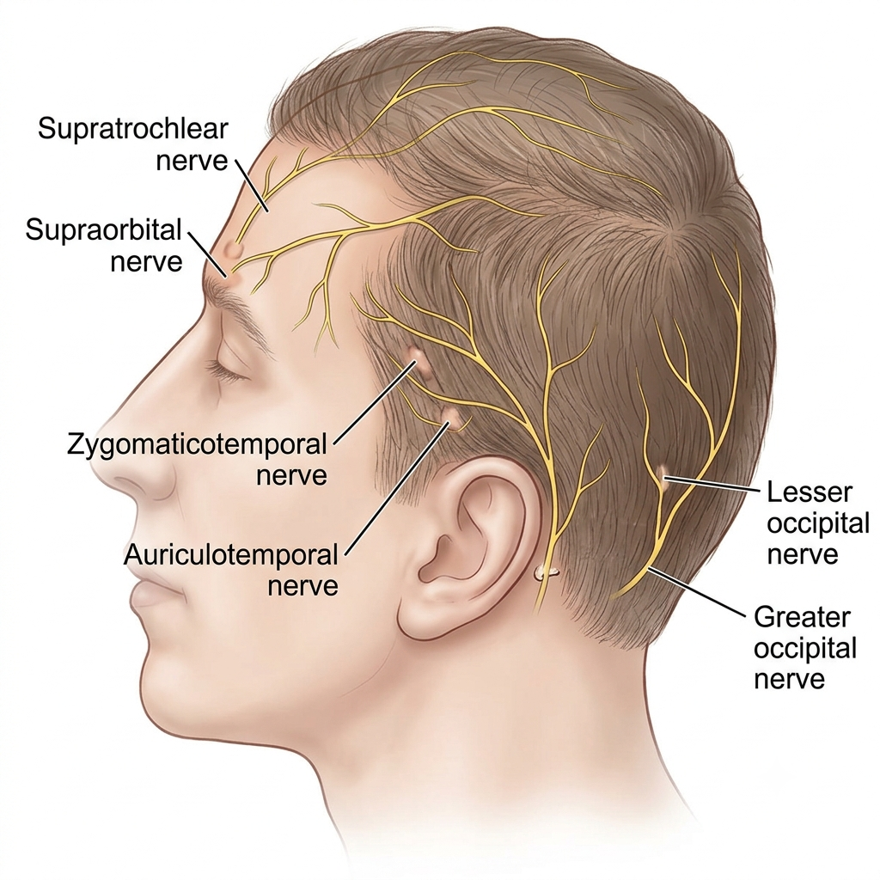
THE ANATOMY
The scalp block is a ring of six nerves, and the one you skip is the wedge that stays awake
Six nerves, and a scalp block is only as complete as the one you remember last. Cover them bilaterally for a craniotomy.
SOURCE
[1] Original figure, A. Cohen, supplied 2026-07-28 · original figure - not from an external source
Alexander Cohen, MD · CC-BY-4.0 · original figure - not from an external source
DRAFT — NOT APPROVED, NOT FOR TEACHING. Preview for review only; no attending has approved this deck.

Slide 6
WHERE THE GUIDANCE SITS
What the guidelines and pooled evidence say
2 findings, each on the slide that follows.
EUROPEAN JOURNAL OF ANAESTHESIOLOGY 2023
CLINICAL NEUROLOGY AND NEUROSURGERY 2025
This PROSPECT systematic review recommends that the analgesic regimen for craniotomy
This meta-analysis found that adding dexmedetomidine to local anaesthetic for scalp
This PROSPECT systematic review recommends that the analgesic regimen for craniotomy should include a regional analgesic technique, specifically…
This meta-analysis found that adding dexmedetomidine to local anaesthetic for scalp nerve blocks in craniotomy patients reduced heart rate by 8.1 bpm…
DRAFT — NOT APPROVED, NOT FOR TEACHING. Preview for review only; no attending has approved this deck.

Slide 7
WHERE THE GUIDANCE SITS
This PROSPECT systematic review recommends that the analgesic regimen for craniotomy
Meta-analysis · European journal of anaesthesiolog
This PROSPECT systematic review recommends that the analgesic regimen for craniotomy should include a regional analgesic technique, specifically either incision-site infiltration or a scalp nerve block, with opioids reserved as rescue analgesics.
SOURCE
[1] Pain management after elective craniotomy: A systematic review with procedure-specific postoperative pain management (PROSPECT) recommendations, European journal of anaesthesiology 2023 · PMID 37417808
DRAFT — NOT APPROVED, NOT FOR TEACHING. Preview for review only; no attending has approved this deck.

Slide 8
WHERE THE GUIDANCE SITS
This meta-analysis found that adding dexmedetomidine to local anaesthetic for scalp
Meta-analysis · Clinical neurology and neurosurger
This meta-analysis found that adding dexmedetomidine to local anaesthetic for scalp nerve blocks in craniotomy patients reduced heart rate by 8.1 bpm and mean arterial pressure by 8.5 mmHg at pin fixation, and prolonged time to first rescue analgesia by 215 minutes.
SOURCE
[1] The efficacy and safety of dexmedetomidine as an adjuvant to local anaesthetics in scalp nerve blocks in patients undergoing craniotomy: A systematic review and meta-analysis of randomized controlled trials, Clinical neurology and neurosurgery 2025 · PMID 41138510
DRAFT — NOT APPROVED, NOT FOR TEACHING. Preview for review only; no attending has approved this deck.

Slide 9
WHAT THE TRIALS FOUND
Where randomised evidence moved the question
2 findings, each on the slide that follows.
CLINICAL NEUROLOGY AND NEUROSURGERY 2025
BMC ANESTHESIOLOGY 2025
This randomized trial found that adding dexmedetomidine 1 mcg/kg instead of
This randomized trial found that a multimodal protocol including a postoperative
This randomized trial found that adding dexmedetomidine 1 mcg/kg instead of dexamethasone 8 mg to 0.5% ropivacaine for scalp nerve blocks in awake…
This randomized trial found that a multimodal protocol including a postoperative bupivacaine scalp block, gabapentin, dexmedetomidine, acetaminophen
DRAFT — NOT APPROVED, NOT FOR TEACHING. Preview for review only; no attending has approved this deck.

Slide 10
WHAT THE TRIALS FOUND
This randomized trial found that adding dexmedetomidine 1 mcg/kg instead of
Randomised trial · Clinical neurology and neurosurger
This randomized trial found that adding dexmedetomidine 1 mcg/kg instead of dexamethasone 8 mg to 0.5% ropivacaine for scalp nerve blocks in awake craniotomy prolongs time to first rescue analgesia to 14 hours and better attenuates the hemodynamic response to skull pin fixation.
SOURCE
[1] Comparison of the efficacy of dexmedetomidine and dexamethasone as adjuvants to ropivacaine for scalp nerve block in patients undergoing awake craniotomy: A randomized controlled trial, Clinical neurology and neurosurgery 2025 · PMID 41197576
DRAFT — NOT APPROVED, NOT FOR TEACHING. Preview for review only; no attending has approved this deck.

Slide 11
WHAT THE TRIALS FOUND
This randomized trial found that a multimodal protocol including a postoperative
Randomised trial · BMC anesthesiology
This randomized trial found that a multimodal protocol including a postoperative bupivacaine scalp block, gabapentin, dexmedetomidine, acetaminophen, and ketorolac significantly reduced VAS pain scores at 1, 2, and 4 hours after elective supratentorial craniotomy compared to IV morphine.
SOURCE
[1] Opioid-sparing multimodal analgesia for post-craniotomy pain: a randomized, double-blind, placebo-controlled trial, BMC anesthesiology 2025 · PMID 40883667
DRAFT — NOT APPROVED, NOT FOR TEACHING. Preview for review only; no attending has approved this deck.

Slide 12
IN PRACTICE
What the cohorts and reviews add
2 findings, each on the slide that follows.
CURRENT PAIN AND HEADACHE REPORTS 2024
NEUROSURGERY CLINICS OF NORTH AMERICA 2022
This review recommends minimizing opioids to facilitate prompt postoperative
This review identifies scalp block as an intraoperative nonopioid analgesic strategy
This review recommends minimizing opioids to facilitate prompt postoperative neurosurgical assessment and found that scalp nerve blocks lower pain…
This review identifies scalp block as an intraoperative nonopioid analgesic strategy for neurosurgery, noting that multimodal analgesia incorporating…
DRAFT — NOT APPROVED, NOT FOR TEACHING. Preview for review only; no attending has approved this deck.

Slide 13
IN PRACTICE
This review recommends minimizing opioids to facilitate prompt postoperative
Review · Current pain and headache reports
This review recommends minimizing opioids to facilitate prompt postoperative neurosurgical assessment and found that scalp nerve blocks lower pain and opioid consumption for the first 48 hours while significantly decreasing postoperative nausea and vomiting.
SOURCE
[1] Nerve Blocks for Craniotomy, Current pain and headache reports 2024 · PMID 38472617
DRAFT — NOT APPROVED, NOT FOR TEACHING. Preview for review only; no attending has approved this deck.

Slide 14
IN PRACTICE
This review identifies scalp block as an intraoperative nonopioid analgesic strategy
Review · Neurosurgery clinics of North Amer
This review identifies scalp block as an intraoperative nonopioid analgesic strategy for neurosurgery, noting that multimodal analgesia incorporating these blocks may be most effective.
SOURCE
[1] Nonopioid Postoperative Pain Management in Neurosurgery, Neurosurgery clinics of North America 2022 · PMID 35718395
DRAFT — NOT APPROVED, NOT FOR TEACHING. Preview for review only; no attending has approved this deck.

Slide 15
INDICATIONS
When this is the right block
SCALP BLOCK IN CRANIOTOMY SYSTEMATIC REVIEW AND META-ANALYSIS, NEUROSURGERY 2023
SCALP NERVE BLOCK AND HAEMODYNAMIC RESPONSE META-ANALYSIS, MINERVA ANESTESIOL 2023
ANESTHETIC CONSIDERATIONS FOR AWAKE CRANIOTOMY, ANESTH PAIN MED 2020
Postoperative analgesia after craniotomy
Blunting the pressor response to skull pin insertion
Awake craniotomy
Propofol, remifentanil, dexmedetomidine and scalp nerve block provide reliable conditions for intra-operative brain mapping under either the asleep-awake-asleep technique or monitored anaesthesia care.
Across 23 randomised trials in 1532 patients, scalp block reduced visual analogue pain scores from 2 through 72 hours by mean differences of 0.79 to 1.40, and cut opioid requirement by 16.5 morphine milligram equivalents at 24 hours and 15.6 at 48 hours. This is the first level 1A evidence for the technique in craniotomy.
Compared with no block, scalp nerve block lowered mean arterial pressure by 14.0 mmHg and heart rate by 11.6 beats per minute during skull pin insertion, and reduced the incidence of intra-operative hypertension.
DRAFT — NOT APPROVED, NOT FOR TEACHING. Preview for review only; no attending has approved this deck.

Slide 16
CONTRAINDICATIONS
When it is not
ASRA LOCAL ANESTHETIC SYSTEMIC TOXICITY CHECKLIST, 2020 VERSION, REG ANESTH PAIN MED 2021
ASRA ANTITHROMBOTIC GUIDELINES, 5TH EDITION, REG ANESTH PAIN MED 2025
REGIONAL ANESTHESIA IN PATIENTS WITH PREEXISTING NEUROLOGIC DISEASE, REG ANESTH PAIN MED 2015
Proceeding without lipid emulsion and the toxicity drill in the room
Antithrombotic therapy still inside the ASRA interval
An unrecorded cranial nerve or scalp sensory baseline
This is a bilateral, multi-nerve injection into a well-vascularised field, and the dose adds up quickly across six nerves per side. ASRA maintains a local anaesthetic systemic toxicity checklist and cognitive aid, updated in 2020 in response to simulation studies and user feedback, precisely because this event happens with the drapes already up.
ASRA's fifth edition proposes conservative interruption times for antithrombotic and thrombolytic therapy before neural blockade and notes that the rarity of haemorrhagic complications means no trial will ever settle the question. In a patient already heading for intracranial surgery, take the conservative interval.
ASRA's advisory on regional anaesthesia in pre-existing neurologic disease reports strengthened evidence that already-compromised nerves may be more susceptible to injury, and adds postsurgical inflammatory neuropathy as a further contributor to postoperative deficit. Record what is already abnormal before you inject.
DRAFT — NOT APPROVED, NOT FOR TEACHING. Preview for review only; no attending has approved this deck.

Slide 17
PEARLS
What experience adds
SCALP BLOCK FOR POSTOPERATIVE PAIN AFTER CRANIOTOMY META-ANALYSIS, FRONT SURG 2022
SCALP NERVE BLOCK AND HAEMODYNAMIC RESPONSE META-ANALYSIS, MINERVA ANESTESIOL 2023
Draw the six nerves before you draw up the drug
Timing does not appear to matter
A block is not the same as infiltration
In a meta-analysis of 12 randomised trials, subgroup analysis found no significant difference in analgesic effect between pre-incision and post-incision scalp block at any period, and no significant difference in the incidence of complications between blocked and unblocked patients.
Mark supraorbital, supratrochlear, zygomaticotemporal, auriculotemporal, greater occipital and lesser occipital on the head with the surgeon present, so the pin sites and the incision are agreed before anything is injected. Sorting that out with a needle in your hand is how nerves get missed.
Compared with scalp infiltration specifically, the nerve block reduced mean arterial pressure and heart rate during pin insertion but not during skin incision. Where the pins are the stimulus, the named-nerve block is the one that earns its place.
DRAFT — NOT APPROVED, NOT FOR TEACHING. Preview for review only; no attending has approved this deck.

Slide 18
IN THE ROOM
What this changes about the next case
Colour is the strength of the evidence behind each step, not the urgency.
1
This PROSPECT systematic review recommends that the analgesic regimen for craniotomy should include a regional analgesic technique, specifically either incision-site infiltration or a scalp nerve block, with opioids reserved as rescue analgesics.
2
This meta-analysis found that adding dexmedetomidine to local anaesthetic for scalp nerve blocks in craniotomy patients reduced heart rate by 8.1 bpm and mean arterial pressure by 8.5 mmHg at pin fixation, and prolonged time to first rescue analgesia by 215 minutes.
3
This randomized trial found that adding dexmedetomidine 1 mcg/kg instead of dexamethasone 8 mg to 0.5% ropivacaine for scalp nerve blocks in awake craniotomy prolongs time to first rescue analgesia to 14 hours and better attenuates the hemodynamic response to skull pin fixation.
4
This randomized trial found that a multimodal protocol including a postoperative bupivacaine scalp block, gabapentin, dexmedetomidine, acetaminophen, and ketorolac significantly reduced VAS pain scores at 1, 2, and 4 hours after elective supratentorial craniotomy compared to IV morphine.
5
This review recommends minimizing opioids to facilitate prompt postoperative neurosurgical assessment and found that scalp nerve blocks lower pain and opioid consumption for the first 48 hours while significantly decreasing postoperative nausea and vomiting.
DRAFT — NOT APPROVED, NOT FOR TEACHING. Preview for review only; no attending has approved this deck.

Slide 19
KEY TAKEAWAYS
What to carry into the next case
This PROSPECT systematic review recommends that the analgesic regimen for craniotomy
This meta-analysis found that adding dexmedetomidine to local anaesthetic for scalp
This randomized trial found that adding dexmedetomidine 1 mcg/kg instead of
This review recommends minimizing opioids to facilitate prompt postoperative
Clinical neurology and neurosurgery 2025
European journal of anaesthesiology 2023
Clinical neurology and neurosurgery 2025
Current pain and headache reports 2024
This PROSPECT systematic review recommends that the analgesic regimen for craniotomy
DRAFT — NOT APPROVED, NOT FOR TEACHING. Preview for review only; no attending has approved this deck.

Slide 20
IN THE ROOM
Questions I'll ask you
Think them through before we start, not while I am asking.
How does your plan change if the patient is not optimised?
What is the physiology behind what we just did?
1
2
Talk me through the trade-off you made there.
What would make you abandon this plan and do something else?
3
4
DRAFT — NOT APPROVED, NOT FOR TEACHING. Preview for review only; no attending has approved this deck.
Notes:
These are prompts, not a checklist. Follow the ones that go somewhere.

Slide 21
BOARD QUESTION · 1 OF 3
Work it before you look
Answer on the next slide.
A meta-analysis of randomised trials asked whether a scalp nerve block blunts the haemodynamic response to skull-pin insertion in adults having elective craniotomy, compared with scalp infiltration or no block. What were the pooled differences at pin insertion, and what happened to intraoperative opioid use?
A.
B.
Mean arterial pressure about 14 mmHg lower and heart rate about 12 beats/min lower, with no difference in intraoperative opioid dose
Mean arterial pressure about 14 mmHg lower and heart rate about 12 beats/min lower, together with a significant fall in intraoperative opioid dose
C.
D.
Mean arterial pressure about 4 mmHg lower with no significant change in heart rate
No difference in mean arterial pressure or heart rate at pin insertion; the benefit appeared only at skin incision
DRAFT — NOT APPROVED, NOT FOR TEACHING. Preview for review only; no attending has approved this deck.
Notes:
Answer: Mean arterial pressure about 14 mmHg lower and heart rate about 12 beats/min lower, with no difference in intraoperative opioid dose. The block also reduced the incidence of intraoperative hypertension, and a similar but smaller effect was seen at skin incision (about 9 mmHg and 9 beats/min). In the subgroup analysis, the scalp block beat scalp infiltration at pin insertion but not at incision — which is what you would expect if the pins are the stimulus a field block is best placed to cover, though the review reports the subgroup result without testing that explanation. [Luo M et al., The effectiveness of scalp nerve block on hemodynamic response in craniotomy: a systematic review and meta-analysis of randomized trials, Minerva Anestesiol 2023]

Slide 22
BOARD QUESTION · 1 OF 3
The answer
A.
B.
Mean arterial pressure about 14 mmHg lower and heart rate about 12 beats/min lower, with no difference in intraoperative opioid dose
Mean arterial pressure about 14 mmHg lower and heart rate about 12 beats/min lower, together with a significant fall in intraoperative opioid dose
C.
D.
Mean arterial pressure about 4 mmHg lower with no significant change in heart rate
No difference in mean arterial pressure or heart rate at pin insertion; the benefit appeared only at skin incision
The block also reduced the incidence of intraoperative hypertension, and a similar but smaller effect was seen at skin incision (about 9 mmHg and 9 beats/min). In the subgroup analysis, the scalp block beat scalp infiltration at pin insertion but not at incision — which is what you would expect if the pins are the stimulus a field block is best placed to cover, though the review reports the subgroup result without testing that explanation.
[1] Luo M et al., The effectiveness of scalp nerve block on hemodynamic response in craniotomy: a systematic review and meta-analysis of randomized trials, Minerva Anestesiol 2023 · PMID 36448987
DRAFT — NOT APPROVED, NOT FOR TEACHING. Preview for review only; no attending has approved this deck.

Slide 23
BOARD QUESTION · 2 OF 3
Work it before you look
Answer on the next slide.
In the randomised, placebo-controlled trial that compared scalp block, local infiltration at the pin sites, and routine anaesthesia alone for skull-pin insertion, name the nerves the scalp block covered and state what the trial measured beyond blood pressure and heart rate.
DRAFT — NOT APPROVED, NOT FOR TEACHING. Preview for review only; no attending has approved this deck.
Notes:
Answer: The block covered the supraorbital, supratrochlear, auriculotemporal, occipital and postauricular branches of the greater auricular nerves, using 20 ml of 0.5% bupivacaine. Beyond haemodynamics the trial measured the endocrine stress response — plasma cortisol and adrenocorticotropic hormone, sampled 5 minutes before induction and 5 and 60 minutes after the pin holder went on. Heart rate and mean arterial pressure rose during pinning in the infiltration and control groups but not in the scalp block group, and cortisol and ACTH at both post-pinning time points were significantly lower after the scalp block than after either infiltration or routine anaesthesia.. Infiltration at the pin sites was not equivalent to the block: on both haemodynamics and stress hormones the block did better, and that is what the authors conclude. Why it did better is not something this trial tested. The familiar account — that a field block of the named nerves is less dependent on each pin landing exactly where you infiltrated — is an explanation offered for the result rather than a finding of it. [Geze S et al., The effect of scalp block and local infiltration on the haemodynamic and stress response to skull-pin placement for craniotomy, Eur J Anaesthesiol 2009]

Slide 24
BOARD QUESTION · 2 OF 3
The answer
The block covered the supraorbital, supratrochlear, auriculotemporal, occipital and postauricular branches of the greater auricular nerves, using 20 ml of 0.5% bupivacaine. Beyond haemodynamics the trial measured the endocrine stress response — plasma cortisol and adrenocorticotropic hormone, sampled 5 minutes before induction and 5 and 60 minutes after the pin holder went on. Heart rate and mean arterial pressure rose during pinning in the infiltration and control groups but not in the scalp block group, and cortisol and ACTH at both post-pinning time points were significantly lower after the scalp block than after either infiltration or routine anaesthesia.
Infiltration at the pin sites was not equivalent to the block: on both haemodynamics and stress hormones the block did better, and that is what the authors conclude. Why it did better is not something this trial tested. The familiar account — that a field block of the named nerves is less dependent on each pin landing exactly where you infiltrated — is an explanation offered for the result rather than a finding of it.
[1] Geze S et al., The effect of scalp block and local infiltration on the haemodynamic and stress response to skull-pin placement for craniotomy, Eur J Anaesthesiol 2009 · PMID 19262392
DRAFT — NOT APPROVED, NOT FOR TEACHING. Preview for review only; no attending has approved this deck.

Slide 25
BOARD QUESTION · 3 OF 3
Work it before you look
Answer on the next slide.
A systematic review and meta-analysis of 23 randomised trials in 1532 patients examined scalp block for postoperative pain and opioid use after craniotomy. Give the size of the analgesic and opioid-sparing effects, and say how you would present those numbers when arguing for the block on a neurosurgical pathway.
DRAFT — NOT APPROVED, NOT FOR TEACHING. Preview for review only; no attending has approved this deck.
Notes:
Answer: Scalp block reduced postoperative visual analogue pain scores from 2 through 72 hours, by mean differences of 0.79 to 1.40 points, and reduced opioid requirement by 16.52 morphine milligram equivalents at 24 hours and 15.63 at 48 hours. Overall risk of bias across the trials was low. The honest presentation is that these are modest absolute reductions — around one point of pain and about 16 morphine milligram equivalents — and that is how the authors themselves ask them to be read: the clinical utility of the differences should be interpreted in the context of the modest absolute size, of overall care optimisation, and of the patient population. Note the limits of what you can quote from this paper: it measured pain and opioid consumption, so it will support an argument that the block is a real if small addition to an opioid-sparing pathway, but it did not measure the block's cost, its procedure time or its complication rate, and an argument resting on those has to be sourced elsewhere.. This is the largest randomised evidence base for the block, and the authors themselves ask that the differences be read against the modest absolute size and against the population being treated. Whether a one-point pain reduction and about 16 morphine milligram equivalents matter more in a neurosurgical patient than elsewhere is a judgement this review invites and does not make. [Duda T et al., Systematic Review and Meta-Analysis of Randomized Controlled Trials for Scalp Block in Craniotomy, Neurosurgery 2023]

Slide 26
BOARD QUESTION · 3 OF 3
The answer
Scalp block reduced postoperative visual analogue pain scores from 2 through 72 hours, by mean differences of 0.79 to 1.40 points, and reduced opioid requirement by 16.52 morphine milligram equivalents at 24 hours and 15.63 at 48 hours. Overall risk of bias across the trials was low. The honest presentation is that these are modest absolute reductions — around one point of pain and about 16 morphine milligram equivalents — and that is how the authors themselves ask them to be read: the clinical utility of the differences should be interpreted in the context of the modest absolute size, of overall care optimisation, and of the patient population. Note the limits of what you can quote from this paper: it measured pain and opioid consumption, so it will support an argument that the block is a real if small addition to an opioid-sparing pathway, but it did not measure the block's cost, its procedure time or its complication rate, and an argument resting on those has to be sourced elsewhere.
This is the largest randomised evidence base for the block, and the authors themselves ask that the differences be read against the modest absolute size and against the population being treated. Whether a one-point pain reduction and about 16 morphine milligram equivalents matter more in a neurosurgical patient than elsewhere is a judgement this review invites and does not make.
[1] Duda T et al., Systematic Review and Meta-Analysis of Randomized Controlled Trials for Scalp Block in Craniotomy, Neurosurgery 2023 · PMID 36762905
DRAFT — NOT APPROVED, NOT FOR TEACHING. Preview for review only; no attending has approved this deck.

Slide 27
EVIDENCE
Sources
Each was resolved against PubMed or a DOI resolver before reaching this deck.
[1] | Pain management after elective craniotomy: A systematic review with procedure-specific postoperative pain management (PROSPECT) recommendations, European journal of anaesthesiology 2023 | PMID 37417808
[2] | The efficacy and safety of dexmedetomidine as an adjuvant to local anaesthetics in scalp nerve blocks in patients undergoing craniotomy: A systematic review and meta-analysis of randomized controlled trials, Clinical neurology and neurosurgery 2025 | PMID 41138510
[3] | Comparison of the efficacy of dexmedetomidine and dexamethasone as adjuvants to ropivacaine for scalp nerve block in patients undergoing awake craniotomy: A randomized controlled trial, Clinical neurology and neurosurgery 2025 | PMID 41197576
[4] | Nerve Blocks for Craniotomy, Current pain and headache reports 2024 | PMID 38472617
[5] | Opioid-sparing multimodal analgesia for post-craniotomy pain: a randomized, double-blind, placebo-controlled trial, BMC anesthesiology 2025 | PMID 40883667
[6] | Nonopioid Postoperative Pain Management in Neurosurgery, Neurosurgery clinics of North America 2022 | PMID 35718395
[7] | Scalp block in craniotomy systematic review and meta-analysis, Neurosurgery 2023 | PMID 36762905
[8] | Scalp nerve block and haemodynamic response meta-analysis, Minerva Anestesiol 2023 | PMID 36448987
[9] | Anesthetic considerations for awake craniotomy, Anesth Pain Med 2020 | PMID 33329824
[10] | ASRA Local Anesthetic Systemic Toxicity checklist, 2020 version, Reg Anesth Pain Med 2021 | PMID 33148630
[11] | ASRA antithrombotic guidelines, 5th edition, Reg Anesth Pain Med 2025 | PMID 39880411
[12] | Regional anesthesia in patients with preexisting neurologic disease, Reg Anesth Pain Med 2015 | PMID 26115188
[13] | Scalp block for postoperative pain after craniotomy meta-analysis, Front Surg 2022 | PMID 36225222
Nothing was removed at the citation check for this topic.
DRAFT — NOT APPROVED, NOT FOR TEACHING. Preview for review only; no attending has approved this deck.

Slide 28
THE ONE THING
This PROSPECT systematic review recommends that the analgesic regimen for craniotomy
DRAFT — NOT APPROVED, NOT FOR TEACHING. Preview for review only; no attending has approved this deck.

